Slide 1


Chapter 6
Dynamic Programming
Slides by Kevin Wayne.
Copyright © 2005 Pearson-Addison Wesley.
All rights reserved.

Slide 2
Algorithmic Paradigms
Greedy. Build up a solution incrementally, myopically optimizing some local criterion.
Divide-and-conquer. Break up a problem into sub-problems, solve each sub-problem independently, and combine solution to sub-problems to form solution to original problem.
Dynamic programming. Break up a problem into a series of overlapping sub-problems, and build up solutions to larger and larger sub-problems.
Notes:
overlapping sub-problem = sub-problem whose results can be reused several times

Slide 3
Dynamic Programming History
Bellman. [1950s] Pioneered the systematic study of dynamic programming.
Etymology.
  Dynamic programming = planning over time.
  Secretary of Defense was hostile to mathematical research.
  Bellman sought an impressive name to avoid confrontation.
"it's impossible to use dynamic in a pejorative sense"
"something not even a Congressman could object to"
Reference: Bellman, R. E. Eye of the Hurricane, An Autobiography.

Slide 4
Dynamic Programming Applications
Areas.
  Bioinformatics.
  Control theory.
  Information theory.
  Operations research.
  Computer science: theory, graphics, AI, compilers, systems, ….
Some famous dynamic programming algorithms.
  Unix diff for comparing two files.
  Viterbi for hidden Markov models.
  Smith-Waterman for genetic sequence alignment.
  Bellman-Ford for shortest path routing in networks.
  Cocke-Kasami-Younger for parsing context free grammars.

Slide 5
6.1 Weighted Interval Scheduling
Notes:
1-24,26-37

Slide 6
Weighted Interval Scheduling
Weighted interval scheduling problem.
  Job j starts at s_{j}, finishes at f_{j}, and has weight or value v_{j} .
  Two jobs compatible if they don't overlap.
  Goal: find maximum weight subset of mutually compatible jobs.
a
b
c
d
e
f
g
h
Time
0
1
2
3
4
5
6
7
8
9
10

Slide 7
Unweighted Interval Scheduling Review
Recall. Greedy algorithm works if all weights are 1.
  Consider jobs in ascending order of finish time.
  Add job to subset if it is compatible with previously chosen jobs.
Observation. Greedy algorithm can fail spectacularly if arbitrary weights are allowed.
weight = 999
b
weight = 1
a
Time
0
1
2
3
4
5
6
7
8
9
10
11

Slide 8
Weighted Interval Scheduling
Notation. Label jobs by finishing time: f₁ ≤ f₂ ≤ . . . ≤ f_{n} .
Def. p(j) = largest index i < j such that job i is compatible with j.
Ex: p(8) = 5, p(7) = 3, p(2) = 0.
1
2
3
4
5
6
7
8
Time
0
1
2
3
4
5
6
7
8
9
10
11

Slide 9
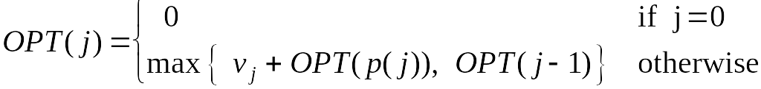
Dynamic Programming: Binary Choice
Notation. OPT(j) = value of optimal solution to the problem consisting of job requests 1, 2, ..., j.
  Case 1: OPT selects job j.
    collect profit v_{j}
    can't use incompatible jobs { p(j) + 1, p(j) + 2, ..., j - 1 }
    must include optimal solution to problem consisting of remaining compatible jobs 1, 2, ..., p(j)
  Case 2: OPT does not select job j.
    must include optimal solution to problem consisting of remaining compatible jobs 1, 2, ..., j-1
optimal substructure

Slide 10
Weighted Interval Scheduling: Brute Force
Brute force algorithm.
Input: n, s₁,…,s_{n ,} f₁,…,f_{n ,} v₁,…,v_{n}
Sort jobs by finish times so that f₁ ≤ f₂ ≤ ... ≤ f_{n}.
Compute p(1), p(2), …, p(n)
Compute-Opt(j) {
if (j = 0)
return 0
else
return max(v_{j} + Compute-Opt(p(j)), Compute-Opt(j-1))
}

Slide 11
Weighted Interval Scheduling: Brute Force
Observation. Recursive algorithm fails spectacularly because of redundant sub-problems ⇒ exponential algorithms.
Ex. Number of recursive calls for family of "layered" instances grows like Fibonacci sequence.
5
1
4
3
2
3
3
2
2
1
4
2
1
1
0
1
0
5
p(1) = 0, p(j) = j-2
1
0

Slide 12
Weighted Interval Scheduling: Memoization
Memoization. Store results of each sub-problem in a cache;
lookup as needed.
Input: n, s₁,…,s_{n ,} f₁,…,f_{n ,} v₁,…,v_{n}
Sort jobs by finish times so that f₁ ≤ f₂ ≤ ... ≤ f_{n}.
Compute p(1), p(2), …, p(n)
for j = 1 to n
M[j] = empty
M[0] = 0
M-Compute-Opt(j) {
if (M[j] is empty)
M[j] = max(v_{j} + M-Compute-Opt(p(j)), M-Compute-Opt(j-1))
return M[j]
}
global array

Slide 13
Weighted Interval Scheduling: Running Time
Claim. Memoized version of algorithm takes O(n log n) time.
  Sort by finish time: O(n log n).
  Computing p(⋅) : O(n log n) via sorting by start time.
  M-Compute-Opt(j): each invocation takes O(1) time and either
    (i) returns an existing value M[j]
    (ii) fills in one new entry M[j] and makes two recursive calls
  Progress measure Φ = # nonempty entries of M[].
    initially Φ = 0, throughout Φ ≤ n.
    (ii) increases Φ by 1 ⇒ at most 2n recursive calls.
  Overall running time of M-Compute-Opt(n) is O(n). ▪
Remark. O(n) if jobs are pre-sorted by start and finish times.

Slide 14
Weighted Interval Scheduling: Finding a Solution
Q. Dynamic programming algorithms computes optimal value.
What if we want the solution itself?
A. Do some post-processing.
  # of recursive calls ≤ n ⇒ O(n).
Run M-Compute-Opt(n)
Run Find-Solution(n)
Find-Solution(j) {
if (j = 0)
output nothing
else if (v_{j} + M[p(j)] > M[j-1])
print j
Find-Solution(p(j))
else
Find-Solution(j-1)
}

Slide 15
Weighted Interval Scheduling: Bottom-Up
Bottom-up dynamic programming. Unwind recursion.
Input: n, s₁,…,s_{n ,} f₁,…,f_{n ,} v₁,…,v_{n}
Sort jobs by finish times so that f₁ ≤ f₂ ≤ ... ≤ f_{n}.
Compute p(1), p(2), …, p(n)
Iterative-Compute-Opt {
M[0] = 0
for j = 1 to n
M[j] = max(v_{j} + M[p(j)], M[j-1])
}

Slide 16
6.3 Segmented Least Squares
Notes:
1-24,26-37

Slide 17
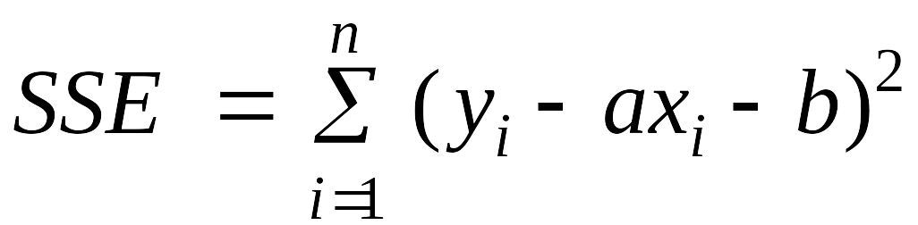
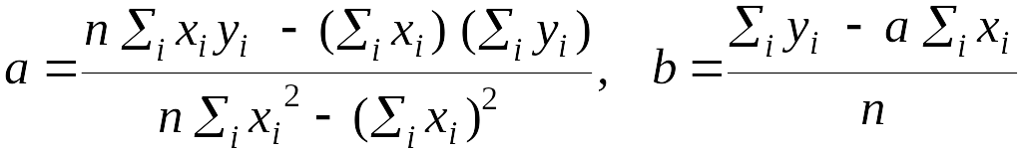
Segmented Least Squares
Least squares.
  Foundational problem in statistic and numerical analysis.
  Given n points in the plane: (x₁, y₁), (x₂, y₂) , . . . , (x_{n}, y_{n}).
  Find a line y = ax + b that minimizes the sum of the squared error:
Solution. Calculus ⇒ min error is achieved when
y
x
Notes:
the term "regression" stems from the work of Sir Francis Galton (1822-1911), a famous geneticist, who studied the heights of fathers and their sons. He found that offspring of a parent of larger than average height tended to be smaller than their parents, and offspring of parents of smaller than average size tended to be larger than their parents. "regression toward mediocrity".
Gauss (1809-1811) used Gaussian elimination to solve multiple linear regression
Gauss-Markov theorem (least squares estimates are uniformly minimum variance estimates (UMVUE) among all linear unbiased estimates)

Slide 18
Segmented Least Squares
Segmented least squares.
  Points lie roughly on a sequence of several line segments.
  Given n points in the plane (x₁, y₁), (x₂, y₂) , . . . , (x_{n}, y_{n}) with
  x₁ < x₂ < ... < x_{n}, find a sequence of lines that minimizes f(x).
Q. What's a reasonable choice for f(x) to balance accuracy and parsimony?
goodness of fit
number of lines
y
x

Slide 19
Segmented Least Squares
Segmented least squares.
  Points lie roughly on a sequence of several line segments.
  Given n points in the plane (x₁, y₁), (x₂, y₂) , . . . , (x_{n}, y_{n}) with
  x₁ < x₂ < ... < x_{n}, find a sequence of lines that minimizes:
    the sum of the sums of the squared errors E in each segment
    the number of lines L
  Tradeoff function: E + c L, for some constant c > 0.
y
x

Slide 20
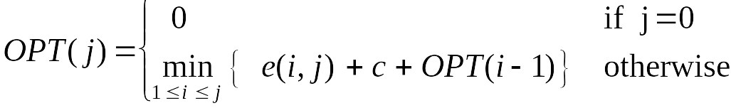
Dynamic Programming: Multiway Choice
Notation.
  OPT(j) = minimum cost for points p₁, p_{i+1} , . . . , p_{j}.
  e(i, j) = minimum sum of squares for points p_{i}, p_{i+1} , . . . , p_{j}.
To compute OPT(j):
  Last segment uses points p_{i}, p_{i+1} , . . . , p_{j} for some i.
  Cost = e(i, j) + c + OPT(i-1).

Slide 21
Segmented Least Squares: Algorithm
Running time. O(n³).
  Bottleneck = computing e(i, j) for O(n²) pairs, O(n) per pair using previous formula.
INPUT: n, p₁,…,p_{N ,} c
Segmented-Least-Squares() {
M[0] = 0
for j = 1 to n
for i = 1 to j
compute the least square error e_{ij} for
the segment p_{i},…, p_{j}
for j = 1 to n
M[j] = min _{1 ≤ i ≤ j} (e_{ij} + c + M[i-1])
return M[n]
}
can be improved to O(n²) by pre-computing various statistics

Slide 22
6.4 Knapsack Problem
Notes:
1-24,26-37

Slide 23
Knapsack Problem
Knapsack problem.
  Given n objects and a "knapsack."
  Item i weighs w_{i} > 0 kilograms and has value v_{i} > 0.
  Knapsack has capacity of W kilograms.
  Goal: fill knapsack so as to maximize total value.
Ex: { 3, 4 } has value 40.
Greedy: repeatedly add item with maximum ratio v_{i} / w_{i}.
Ex: { 5, 2, 1 } achieves only value = 35 ⇒ greedy not optimal.
#
value
weight
1
1
1
W = 11
2
6
2
3
18
5
4
22
6
5
28
7

Slide 24
Dynamic Programming: False Start
Def. OPT(i) = max profit subset of items 1, …, i.
  Case 1: OPT does not select item i.
    OPT selects best of { 1, 2, …, i-1 }
  Case 2: OPT selects item i.
    accepting item i does not immediately imply that we will have to reject other items
    without knowing what other items were selected before i,
    we don't even know if we have enough room for i
Conclusion. Need more sub-problems!

Slide 25
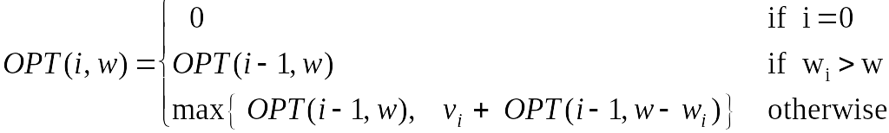
Dynamic Programming: Adding a New Variable
Def. OPT(i, w) = max profit subset of items 1, …, i with weight limit w.
  Case 1: OPT does not select item i.
    OPT selects best of { 1, 2, …, i-1 } using weight limit w
  Case 2: OPT selects item i.
    new weight limit = w – w_{i}
    OPT selects best of { 1, 2, …, i–1 } using this new weight limit

Slide 26
Knapsack Problem: Bottom-Up
Knapsack. Fill up an n-by-W array.
Input: n, W, w₁,…,w_{N,} v₁,…,v_{N}
for w = 0 to W
M[0, w] = 0
for i = 1 to n
for w = 1 to W
if (w_{i} > w)
M[i, w] = M[i-1, w]
else
M[i, w] = max {M[i-1, w], v_{i} + M[i-1, w-w_{i} ]}
return M[n, W]

Slide 27
Knapsack Algorithm
W + 1
0
1
2
3
4
5
6
7
8
9
10
11
φ
0
0
0
0
0
0
0
0
0
0
0
0
{ 1 }
0
1
1
1
1
1
1
1
1
1
1
1
n + 1
{ 1, 2 }
0
1
6
7
7
7
7
7
7
7
7
7
{ 1, 2, 3 }
0
1
6
7
7
18
19
24
25
25
25
25
{ 1, 2, 3, 4 }
0
1
6
7
7
18
22
24
28
29
29
40
{ 1, 2, 3, 4, 5 }
0
1
6
7
7
18
22
28
29
34
34
40
Item
Value
Weight
1
1
1
OPT: { 4, 3 }
value = 22 + 18 = 40
2
6
2
W = 11
3
18
5
4
22
6
5
28
7

Slide 28
Knapsack Algorithm: Finding a Solution
Q. Knapsack algorithms computes optimal value.
What if we want the solution itself?
A. Do some post-processing (similar to weighted interval scheduling).
  Start from the last item i=n, and w=W, Considering M[n, W]:
  If M[i, w] = M[i-1, w], then OPT does not include item i.
    We move to consider item M[i-1, w]
  If M[i, w] = v_{i} + M[i-1, w-w_{i} ], then OPT includes current item i. → output item i
    We move to consider item M[i-1, w-w_{i} ]
  # of recursive calls ≤ n ⇒ O(n).

Slide 29
Knapsack Problem: Running Time
Running time. Θ(n W).
  Not polynomial in input size!
  "Pseudo-polynomial."
  Decision version of Knapsack is NP-complete. [Chapter 8]
Knapsack approximation algorithm. There exists a poly-time algorithm that produces a feasible solution that has value within 0.01% of optimum. [Section 11.8]

Slide 30
6.5 RNA Secondary Structure
Notes:
1-24,26-37

Slide 31
RNA Secondary Structure
RNA. String B = b₁b₂…b_{n} over alphabet { A, C, G, U }.
Secondary structure. RNA is single-stranded so it tends to loop back and form base pairs with itself. This structure is essential for understanding behavior of molecule.
Ex: GUCGAUUGAGCGAAUGUAACAACGUGGCUACGGCGAGA
C
A
A
A
A
U
G
C
C
G
U
A
A
G
U
G
A
U
U
A
A
C
G
C
U
G
G
C
G
C
G
A
G
C
G
A
U
complementary base pairs: A-U, C-G
G
Notes:
Adenine, Uracil, Cytosine, Guanine (uracil replaces thymine in mRNA)

Slide 32
RNA Secondary Structure
Secondary structure. A set of pairs S = { (b_{i}, b_{j}) } that satisfy:
  [Watson-Crick.] S is a matching and each pair in S is a Watson-Crick complement: A-U, U-A, C-G, or G-C.
  [No sharp turns.] The ends of each pair are separated by at least 4 intervening bases. If (b_{i}, b_{j}) ∈ S, then i < j - 4.
  [Non-crossing.] If (b_{i}, b_{j}) and (b_{k}, b_{l}) are two pairs in S, then we cannot have i < k < j < l.
Free energy. Usual hypothesis is that an RNA molecule will form the secondary structure with the optimum total free energy.
Goal. Given an RNA molecule B = b₁b₂…b_{n}, find a secondary structure S that maximizes the number of base pairs.
approximate by number of base pairs

Slide 33
RNA Secondary Structure: Examples
Examples.
G
G
G
G
G
C
U
G
G
C
U
C
G
C
G
C
U
A
U
A
U
A
G
U
A
U
A
U
A
base pair
A
U
G
U
G
G
C
C
A
U
A
U
G
G
G
G
C
A
U
A
G
U
U
G
G
C
C
A
U
≤4
ok
sharp turn
crossing

Slide 34
RNA Secondary Structure: Subproblems
First attempt. OPT(j) = maximum number of base pairs in a secondary structure of the substring b₁b₂…b_{j}.
Difficulty. Results in two sub-problems.
  Finding secondary structure in: b₁b₂…b_{t-1}.
  Finding secondary structure in: b_{t+1}b_{t+2}…b_{n-1}.
match b_{t} and b_{n}
1
t
n
OPT(t-1)
need more sub-problems

Slide 35
Dynamic Programming Over Intervals
Notation. OPT(i, j) = maximum number of base pairs in a secondary structure of the substring b_{i}b_{i+1}…b_{j}.
  Case 1. If i ≥ j - 4.
    OPT(i, j) = 0 by no-sharp turns condition.
  Case 2. Base b_{j} is not involved in a pair.
    OPT(i, j) = OPT(i, j-1)
  Case 3. Base b_{j} pairs with b_{t} for some i ≤ t < j - 4.
    non-crossing constraint decouples resulting sub-problems
    OPT(i, j) = 1 + max_{t} { OPT(i, t-1) + OPT(t+1, j-1) }
take max over t such that i ≤ t < j-4 and
b_{t} and b_{j} are Watson-Crick complements

Slide 36

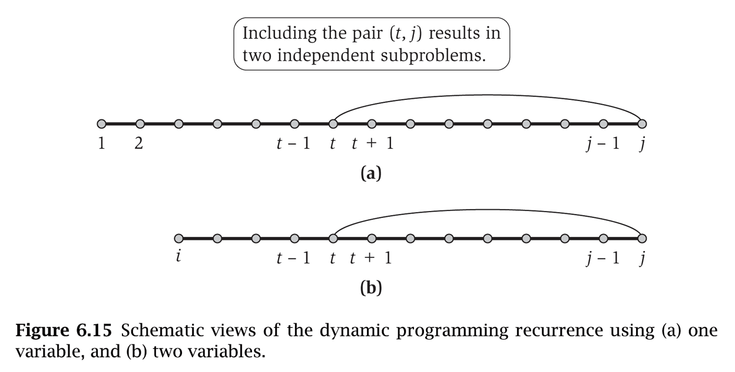

Slide 37
Bottom Up Dynamic Programming Over Intervals
Q. What order to solve the sub-problems?
A. Do shortest intervals first.
Running time. O(n³).
RNA(b₁,…,b_{n}) {
for k = 5, 6, …, n-1
for i = 1, 2, …, n-k
j = i + k
Compute M[i, j]
return M[1, n]
}
4
0
0
0
3
0
0
i
2
0
1
6
7
8
9
j
using recurrence
    OPT(i, j) = max{
    OPT(i, j-1),
    1 + max_{t} { OPT(i, t-1) + OPT(t+1, j-1) }
    }
take max over t such that i ≤ t < j-4 and
b_{t} and b_{j} are Watson-Crick complements
Notes:
Ex: n=9 so k in [5..8], i in [1..4], and j in [6..12]
Compute M[1,9] thus t in [1..4]
M[1,9] = max{M[1,8], 1 + max{M[1, 0]+M[2,8], M[1,1]+M[3,8], M[1,2]+M[4,8], M[1,3]+M[5,8]}} = max{M1,8], 1 + max{0+M[2,8], 0+M[3,8], 0+0, 0+0}}

Slide 38
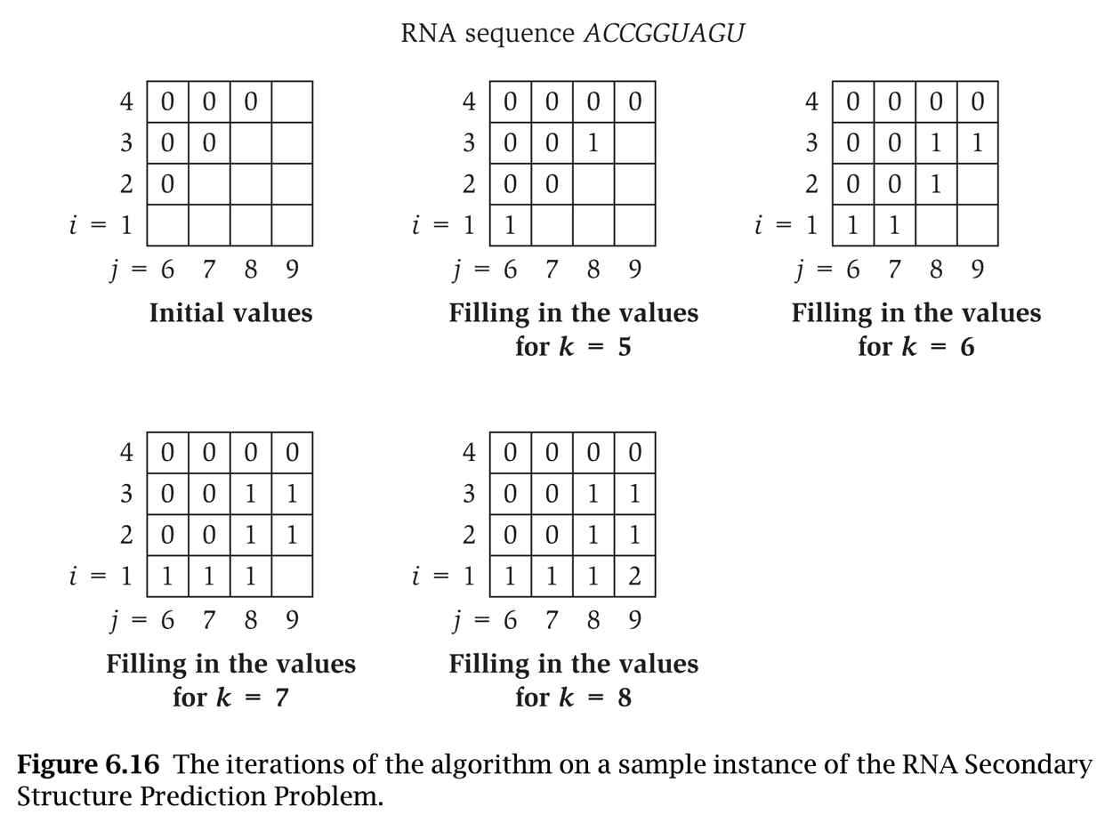
RNA(b₁,…,b_{n}) {
for k = 5, 6, …, n-1
for i = 1, 2, …, n-k
j = i + k
Compute M[i, j]
return M[1, n]
}
Notes:
A-U, U-A, C-G, or G-C
M[1,6] = 1 //A-U
M[1,9] = 1+M[2,8] = 2

Slide 39
Dynamic Programming Summary
Recipe.
  Characterize structure of problem.
  Recursively define value of optimal solution.
  Compute value of optimal solution.
  Construct optimal solution from computed information.
Dynamic programming techniques.
  Binary choice: weighted interval scheduling.
  Multi-way choice: segmented least squares.
  Adding a new variable: knapsack.
  Dynamic programming over intervals: RNA secondary structure.
Top-down vs. bottom-up: different people have different intuitions.
Viterbi algorithm for HMM also uses
DP to optimize a maximum likelihood
tradeoff between parsimony and accuracy
CKY parsing algorithm for context-free
grammar has similar structure

Slide 40
6.6 Sequence Alignment
Notes:
1-24,26-37

Slide 41
String Similarity
How similar are two strings?
  ocurrance
  occurrence
o
c
u
r
r
a
n
c
e
-
o
c
c
u
r
r
e
n
c
e
6 mismatches, 1 gap
o
c
-
u
r
r
a
n
c
e
o
c
c
u
r
r
e
n
c
e
1 mismatch, 1 gap
o
c
-
u
r
r
-
a
n
c
e
o
c
c
u
r
r
e
-
n
c
e
0 mismatches, 3 gaps

Slide 42
Edit Distance
Applications.
  Basis for Unix diff.
  Speech recognition.
  Computational biology.
Edit distance. [Levenshtein 1966, Needleman-Wunsch 1970]
  Gap penalty δ; mismatch penalty α_{pq}.
  Cost = sum of gap and mismatch penalties.
C
T
G
A
C
C
T
A
C
C
T
-
C
T
G
A
C
C
T
A
C
C
T
C
C
T
G
A
C
T
A
C
A
T
C
C
T
G
A
C
-
T
A
C
A
T
α_{TC} + α_{GT} + α_{AG}+ 2α_{CA}
2δ + α_{CA}
Notes:
Levenshtein introduced concept of edit-distance; Needleman-Wunsch first applied it to aligning biological sequences; our algorithm is closest in spirit to Smith-Waterman (but their algorithm is for local alignment)
Presumably alpha_pp = 0, but assumption not needed (could be a profit instead of penalty)
bonus application: spam filter - compare message with known spam messages

Slide 43
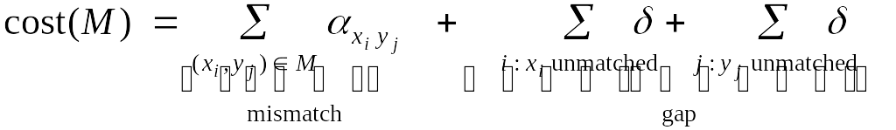
Sequence Alignment
Goal: Given two strings X = x₁ x₂ . . . x_{m} and Y = y₁ y₂ . . . y_{n} find alignment of minimum cost.
Def. An alignment M is a set of ordered pairs x_{i}-y_{j} such that each item occurs in at most one pair and no crossings.
Def. The pair x_{i}-y_{j} and x_{i'}-y_{j'} cross if i < i', but j > j'.
Ex: CTACCG vs. TACATG.
Sol: M = x₂-y₁, x₃-y₂, x₄-y₃, x₅-y₄, x₆-y₆.
x₁
x₂
x₃
x₄
x₅
x₆
C
T
A
C
C
-
G
-
T
A
C
A
T
G
y₁
y₂
y₃
y₄
y₅
y₆

Slide 44
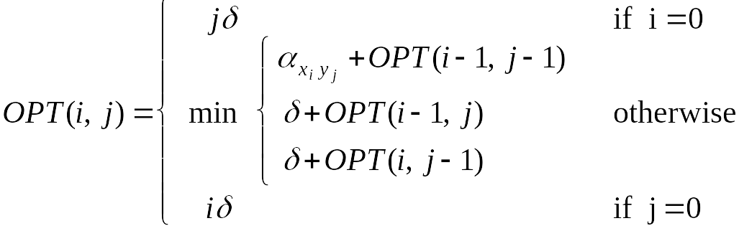
Sequence Alignment: Problem Structure
Def. OPT(i, j) = min cost of aligning strings x₁ x₂ . . . x_{i} and y₁ y₂ . . . y_{j}.
  Case 1: OPT matches x_{i}-y_{j}.
    pay mismatch for x_{i}-y_{j} + min cost of aligning two strings
    x₁ x₂ . . . x_{i-1} and y₁ y₂ . . . y_{j-1}
  Case 2a: OPT leaves x_{i} unmatched.
    pay gap for x_{i} and min cost of aligning x₁ x₂ . . . x_{i-1} and y₁ y₂ . . . y_{j}
  Case 2b: OPT leaves y_{j} unmatched.
    pay gap for y_{j} and min cost of aligning x₁ x₂ . . . x_{i} and y₁ y₂ . . . y_{j-1}

Slide 45
Sequence Alignment: Algorithm
Analysis. Θ(mn) time and space.
English words or sentences: m, n ≤ 10.
Computational biology: m = n = 100,000. 10 billions ops OK, but 10GB array?
Sequence-Alignment(m, n, x₁x₂...x_{m}, y₁y₂...y_{n}, δ, α) {
for i = 0 to m
M[i, 0] = iδ
for j = 0 to n
M[0, j] = jδ
for i = 1 to m
for j = 1 to n
M[i, j] = min(α[x_{i,} y_{j}] + M[i-1, j-1],
δ + M[i-1, j],
δ + M[i, j-1])
return M[m, n]
}
Notes:
Adenine, Uracil, Cytosine, Guanine (uracil replaces thymine in mRNA)
What C? It stands for Deoxyribonucleic acid!!! DNA is made up of A C G & T ACGT stands for the four nucleic acid bases that make up DNA. The A stands for Adenine and pairs with the T, which stands for Thymine. The C stands for Cytosine and pairs with the G, Guanine. These four nucleic acids make up a creature's genetic code, or DNA. A can only match up with T. And C can only match up with G.

Slide 46
6.7 Sequence Alignment in Linear Space
Notes:
1-24,26-37

Slide 47
Sequence Alignment: Linear Space
Q. Can we avoid using quadratic space?
Easy. Optimal value in O(m + n) space and O(mn) time.
  Compute OPT(i, •) from OPT(i-1, •).
  No longer a simple way to recover alignment itself.
Theorem. [Hirschberg 1975] Optimal alignment in O(m + n) space and O(mn) time.
  Clever combination of divide-and-conquer and dynamic programming.
  Inspired by idea of Savitch from complexity theory.

Slide 48
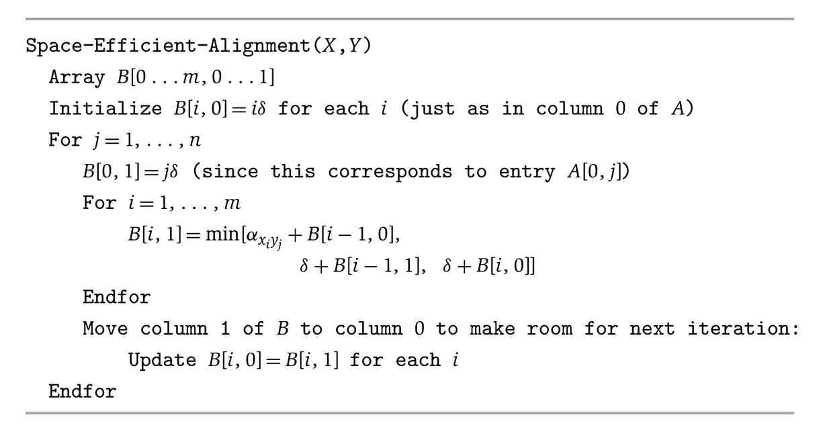
Sequence-Alignment(m, n, x₁x₂...x_{m}, y₁y₂...y_{n}, δ, α) {
for i = 0 to m
M[i, 0] = iδ
for j = 0 to n
M[0, j] = jδ
for i = 1 to m
for j = 1 to n
M[i, j] = min(α[x_{i,} y_{j}] + M[i-1, j-1],
δ + M[i-1, j],
δ + M[i, j-1])
return M[m, n]
}
Observation:
Comput M[i,j] only needs
M[i-1,*] and M[i,*]
Conclusion: Don’t need m*n matrix, just use m*2 matrix

Slide 49

Sequence Alignment: Linear Space
Edit distance graph.
  Let f(i, j) be shortest path from (0,0) to (i, j).
  Observation: f(i, j) = OPT(i, j).
ε
y₁
y₂
y₃
y₄
y₅
y₆
ε
0-0
x₁
δ
x₂
δ
i-j
x₃
m-n
Notes:
edit distanace graph would take Θ(mn) space to write down

Slide 50
Sequence Alignment: Linear Space
Edit distance graph.
  Let f(i, j) be shortest path from (0,0) to (i, j).
j
ε
y₁
y₂
y₃
y₄
y₅
y₆
ε
0-0
x₁
x₂
i-j
x₃
m-n
Notes:
edit distanace graph would take Θ(mn) space to write down

Slide 51
Sequence Alignment: Linear Space
Edit distance graph.
  Let g(i, j) be shortest path from (i, j) to (m, n).
  Can compute by reversing the edge orientations and inverting the roles of (0, 0) and (m, n)
ε
y₁
y₂
y₃
y₄
y₅
y₆
ε
0-0
x₁
i-j
δ
x₂
δ
x₃
m-n

Slide 52
Sequence Alignment: Linear Space
Edit distance graph.
  Let g(i, j) be shortest path from (i, j) to (m, n).
j
ε
y₁
y₂
y₃
y₄
y₅
y₆
ε
0-0
x₁
i-j
x₂
x₃
m-n

Slide 53
Sequence Alignment: Linear Space
Observation 1. The cost of the shortest path that uses (i, j) is
f(i, j) + g(i, j).
ε
y₁
y₂
y₃
y₄
y₅
y₆
ε
0-0
x₁
i-j
x₂
x₃
m-n

Slide 54
Sequence Alignment: Linear Space
Observation 2. let q be an index that minimizes f(q, n/2) + g(q, n/2). Then, the shortest path from (0, 0) to (m, n) uses (q, n/2).
n / 2
ε
y₁
y₂
y₃
y₄
y₅
y₆
ε
0-0
x₁
i-j
q
x₂
x₃
m-n

Slide 55
Sequence Alignment: Linear Space
Divide: find index q that minimizes f(q, n/2) + g(q, n/2) using DP.
  Align x_{q} and y_{n/2}.
Conquer: recursively compute optimal alignment in each piece.
n / 2
ε
y₁
y₂
y₃
y₄
y₅
y₆
ε
0-0
x₁
i-j
q
x₂
x₃
m-n

Slide 56
